Slide 1

Python Programming
(Business & Analytics)
by Su Lee Seng,
Jan, 2021

Slide 2
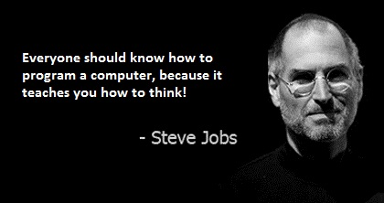
Python Programming
(Business & Analytics)
by Su Lee Seng,
Jan, 2021

Slide 3
Talk is cheap.
show me the code.

Slide 4

SAP HANA – An Introduction
@ UTAR
by Su Lee Seng,
April, 2014.

Slide 5
Python Programming
Flow Control (IF Statements)

Slide 6
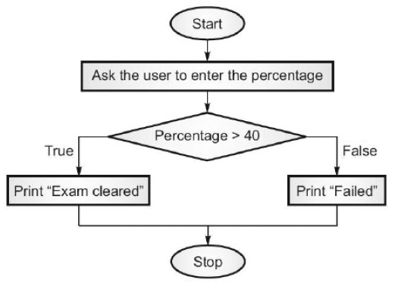
Python Programming – Flow Control (IF Statements) :
IF- Statement
xxxx

Slide 7
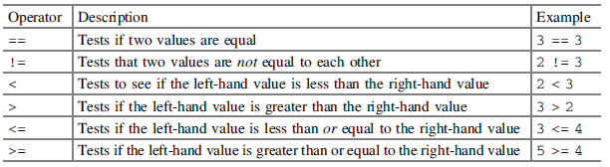
Python Programming – Flow Control (IF Statements) :
Comparison Operators
A comparison operator is an operator that performs some form of test and returns True of False. In Python there are a range of comparison operators represented by typically one or two characters. These are:

Slide 8
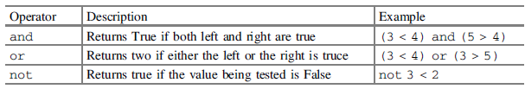
Python Programming – Flow Control (IF Statements) :
Logical Operators
Logical operators can be used to combined Boolean expressions together. Typically, they are used with comparison operators to create more complex conditions. Again, we use these every day for example we might consider whether we can afford an ice cream and whether we will be having our dinner soon etc.
There are three logical operators in Python these are listed below:

Slide 9
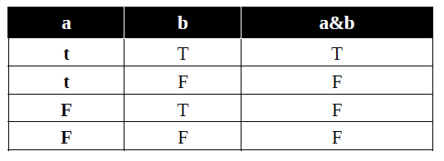
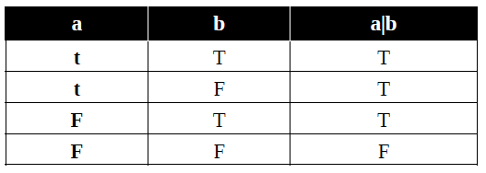
Python Programming – Flow Control (IF Statements) :
Logical Operators
xxx

Slide 10
Python Programming – Flow Control (IF Statements) :
The IF - Statement
In its most basic from, the if statement is
if <condition-evaluating-to-boolean>:
statement
Note that the condition must evaluate to True or False . If the condition is True then we will execute the indented statement.
Note that indentation, this is very important in Python; indeed, layout of the code is very, very important in Python. Indentation is used to determine how one piece of code should be associated with another piece of the code.

Slide 11
Python Programming – Flow Control (IF Statements) :
The IF - Statement
Let us look at a simple example,
num = int(input('Enter a number: '))
if num < 0:
print(num, 'is negative')
…the user has input a number; if it is less than zero a message noting this will be printed to the user. If the number is positive; then nothing will be output.
If we wish to execute multiple statements when our condition is True we can indent several lines; in fact all lines indented to the same level after the if statement will automatically be part of the if statement.
Output :
Enter a number: -1
-1 is negative

Slide 12
Python Programming – Flow Control (IF Statements) :
The IF - Statement
For example;
num = int(input('Enter another number: '))
if num > 0:
print(num, 'is positive')
print(num, 'squared is ', num * num)
print('Bye')
Output :
Enter another number: 2
2 is positive
2 squared is 4
Bye
Output :
Enter another number: -1
Bye

Slide 13
Python Programming – Flow Control (IF Statements) :
Else in an IF Statement
num = int(input('Enter yet another number: '))
if num < 0:
print('Its negative')
else:
print('Its not negative')
Now when this code is executed, if the number entered is less than zero then the first print() statement will be run otherwise (else) the second print() statement will be run. However, we are guaranteed that at least one (and at most one) of the print() statements will execute.
Output :
Enter yet another number: 1
Its not negative
Output :
Enter yet another number: -1
Its negative

Slide 14
Python Programming – Flow Control (IF Statements) :
The Use of elif
The elif element of an if statement follows the if part and comes before any (optional) else part. It has the format:
if <condition-evaluating-to-boolean>:
statement
elif <condition-evaluating-to-boolean>:
statement
Python uses two things to denote blocks:
    • a colon (:)
    • indentation
Use a colon (:) and indenting consistently until the end of the block.

Slide 15
Python Programming – Flow Control (IF Statements) :
The Use of elif
savings = float(input("Enter how much you have in savings: "))
if savings == 0:
print("Sorry no savings")
elif savings < 500:
print('Well done')
elif savings < 1000:
print('Thats a tidy sum')
elif savings < 10000:
print('Welcome Sir!')
else:
print('Thank you')
Output :
Enter how much you have in savings: 500
Thats a tidy sum
Notes:
Here we can see that the first if condition failed (as savings is not equal to 0).
However, the next elif also must have returned False as savings were greater than 500. In fact it was the second elif statement that returned True and thus the associated print('Thats a tidy sum') statement was executed. Having
executed this statement the if statement then terminated (the remaining elif and else parts were ignored).

Slide 16
Python Programming – Flow Control (IF Statements) :
Example : Leap year
if y % 400 == 0:
leap = True
elif y % 100 == 0:
leap = False
elif y % 4 == 0:
leap = True
else:
leap = False

Slide 17
Python Programming – Flow Control (IF Statements) :
Example : Leap year
Since Python evaluates the clauses in a strict order, each elif clause has an implicit "and not any of the previous clauses". This means that the conditions in each elif can be written very succinctly, but they also need the previous clauses as part of their context.
As the number of elif clauses grows, the possibility of introducing a subtle logic bug also grows. This can create the situation where the implied condition for the else clause is very hard to deduce correctly.

Slide 18
Python Programming – Flow Control (IF Statements) :
Example : Leap year
Consequently, some programs include logic that looks like this:
if y % 400 == 0:
leap = True
elif y % 400 != 0 and y % 100 == 0:
leap = False
elif y % 400 != 0 and y % 100 != 0 and y % 4 == 0:
leap = True
elif y % 400 != 0 and y % 100 != 0 and y % 4 != 0:
leap = False
else:
raise Exception("Logic Error")

Slide 19
Python Programming – Flow Control (IF Statements) :
Nesting If Statements
It is possible to nest one if statement inside another. This term nesting indicates that one if statement is located within part of the another if statement and can be used to refine the conditional behaviour of the program.
snowing = True
temp = -1
if temp < 0:
print('It is freezing')
if snowing:
print('Put on boots')
print('Time for Hot Chocolate')
print('Bye')
…is already a Boolean value
Output :
It is freezing
Put on boots
…not part of inner IF statement

Slide 20
Python Programming – Flow Control (IF Statements) :
Nesting If Statements
snowing = True
temp = -1
if temp < 0:
print('It is freezing')
if snowing:
print('Put on boots')
print('Time for Hot Chocolate')
print('Bye')
Output :
It is freezing
Put on boots
Time for Hot Chocolate
…it is now a part of inner IF statement
Notes:
This now changes the inner (or nested) if to have two print statements associated with it.
This may seem subtle, but it is key to how Python uses layout to link together individual statements.

Slide 21
Python Programming – Flow Control (IF Statements) :
IF Expressions
age = 15
status = None
if (age > 12) and age < 20:
status = 'teenager'
else:
status = 'not teenager'
print(status)
…checks if someone is a teenager or not.
Output :
teenager

Slide 22
Python Programming – Flow Control (IF Statements) :
IF Expressions
age = 15
status = None
if (age > 12) and age < 20:
status = 'teenager'
else:
status = 'not teenager'
print(status)
status = ('teenager' if age > 12 and age < 20 else 'not teenager')
print(status)
…checks if someone is a teenager or not.
Output :
teenager
Notes:
That is the result returned from the if expression is the first value unless the condition fails in which case the result returned will be the value after the else. It may seem confusing at first, but it becomes easier when you see an example.

Slide 23
Python Programming – Flow Control (IF Statements) :
A Note on True and False
Python is actually quite flexible when it comes to what actually is used to represent True and False, in fact the following rules apply
• 0, '' (empty strings), None …..equate to False
• Non zero, non empty strings, any object equate to True.
However, it is recommended sticking to just True and False as it is often a cleaner and safer approach.

Slide 24
Python Programming – Flow Control (IF Statements) :
Hints
One thing to be very careful of in Python is layout. Unlike language such as Java and C# the layout of your program is part of your program. It determines how statements are associated together and how flow of control elements such as if statements effect which statements are executed.
Also, be careful with the if statement and its use of the ':' character. This character is key in separating out the conditional part of the if statement from the statements that will be executed depending upon whether the condition is True or False.
<< Exercise B6 >>

Slide 25
Python Programming – Flow Control (IF Statements) :
Online Resources
See the Python Standard Library documentation for:
• https://docs.python.org/3/library/stdtypes.html#boolean-operations-and-or-not Boolean Operations.
• https://docs.python.org/3/library/stdtypes.html#comparisons Comparison operators.
• https://docs.python.org/3/tutorial/controlflow.html the online Python flow of control tutorial.

Slide 26
Thank you

